Slide 1
Essential, responsible, scalable innovation
2023
Quantum Computing
at PwC

Slide 2
Read Me [and delete before sharing]
The purpose of this document is to present interested external audiences (including potential clients) a high-level view of why Quantum Computing is increasingly important to their organizations, and how PwC’s Innovation Hub can help them along their QC journeys.
If you have any questions after consulting this deck, please reach out to Arit Kumar Bishwas.
For additional Innovation Hub sales collateral and more information about our capabilities, service offerings, and frameworks please refer to our Internal Innovation Hub Website.
Thank you,
PwC’s Innovation Hub
PwC Innovation Hub
Confidential information for the sole benefit and use of PwC’s client
2

Slide 3

Contents
01
PwC’s Innovation Hub at a glance
02
PwC’s quantum computing capabilities overview
03
Our impact
PwC Innovation Hub
Confidential information for the sole benefit and use of PwC’s client

Slide 4
PwC’s Innovation Hub at a glance
01
PwC Innovation Hub
Confidential information for the sole benefit and use of PwC’s client

Slide 5

We help clients drive innovation from ideation through development and scale.
EmTech Upskill Sessions
Opportunity Prioritization
ETRx Benchmarking
Solution Development
Innovation doesn’t have to be game changing to change the game for your business. No matter how big or small your idea is, if it’s for your customers or employees, or if it’s for one business unit or the entire enterprise - we can help you scale it to drive tangible business outcomes.
We work with clients to accelerate:
Ideation and innovation at speed to identify challenges and opportunities worth investing in.
Fail fast rapid prototyping and testing to validate user assumption and business alignment.
Speed to launch and stand-up internal operations and change management function leveraging our own PwC product experience.
Market Assessments
Value Drivers/
Success Metrics
Learn it
Ideate on it
Release Planning
Innovative solutions
Performance Measures
Scale it
Invest in it
Solution Launch
Business Case
Make it
Operations/
Maintenance
Proof of Concept
Co-Build
Rapid Prototyping
Hackathon
PwC Innovation Hub
Confidential information for the sole benefit and use of PwC’s client
6

Slide 6
The Innovation Hub is PwC’s innovation engine.
Our team of technologists and business strategists apply their research, insights and expertise to solve today’s challenges and prepare for what’s next.
Web3 AI (e.g., Intelligent Avatars)
Innovation Hub expertise
Core Offerings
Artificial Intelligence [AI]
Firm AI solution delivery: (Tax AI, NGA/Emerging Trust, Scale Plays, AI Factory, Digital Solution Studio)
AI Governance
Emerging AI R&D (next in Foundational Models, High Performance AI, Simulated Enterprise, Human AI Interaction
AI in the Market (segment/client innovation)
Blockchain
Scaling blockchain-enabled carbon value chain
Financial Inclusion
Commercial partnerships
Innovation in blockchain (expanding tax reporting, AI governance, ZK Proofs)
Extended Reality [XR]
Immersive Services
Trust in the Metaverse
Digital product lines
Virtual brand presence
Simulations
Convergence opportunities
Quantum
Quantum Cyber Readiness
Optimization,
Clustering
Ecosystem exploration
Cryptography
Molecular unfolding
Quantum Enterprise Activation
Market insights & innovation strategy
Experimentation & new capability development
Rapid proofs of concept & client co-creation
Solution & new service offering development
Research & Development
Innovation to Market
Emerging tech education
Technology Convergence
Increase profits
Mitigate risk
Create & scale new revenue streams
Drive efficiency & reduce costs
Enhance client & customer experiences
Future proof client business models
PwC Innovation Hub
Confidential information for the sole benefit and use of PwC’s client

Slide 7

Our experience makes the difference…
Expertise
200+ business strategists and technologists, including data scientists, ML engineers, full-stack developers, crypto experts, VR developers, and more
Speed
Focused sprints and a mix of 4000+ code-based assets, apps, frameworks, and templates that accelerate value delivery
Relationships
100+ new ventures, 40+ technology majors and start-ups, and 50+ universities.
Innovation Pilots
180+ sprint cycles since inception; 30-40 PoCs completed annually
Data
1000+ proprietary, synthetic, and 3rd
party data sets to enrich analyses
Services
Application as a Service (AaaS)
Platform as a Service (PaaS)
Software as a Service (SaaS)
And we’re being recognized for our work.
World Economic Forum
Fast Company
Gartner
CogX
IDC
Forrester
PwC’s Responsible AI Toolkit was ranked as the 2020 World Changing Idea
PwC’s Bias Analyzer was selected as the 2021 Next Thing in Tech
PwC was ranked as the Leader for Data & Analytics Services
PwC was recognized for outstanding achievement in Enterprise Adoption of AI and AI Ethics
PwC was ranked as the Marketscape Leader in World-Wide AI services, and Responsible AI for Integrated Financial Crime Management Platforms
PwC has been ranked as an AI Consulting Leader for the past 4 years
PwC’s Blockchain Sustainability Framework is regarded as the leading point of view on sustainable blockchain development
PwC Innovation Hub
Confidential information for the sole benefit and use of PwC’s client
7

Slide 8

2023 Emerging Technology Survey
Our survey shows that a few companies — very few — are getting emerging technologies right. Executives in these organizations report significantly higher benefits from emerging tech in general, and from generative AI (GenAI) in particular, than their peers.
Our survey data not only identifies these companies, it pinpoints four practices that likely explain their success.
Top findings
89% of companies responding are increasing their overall technology budget over the next 12 months, with a fifth (21%) increasing it by more than 10%.
55% of all respondents say their company has invested in AI (i.e., it was within their top 3 priorities) in the last 12 months, more than any other technology listed.
58% of all respondents plan to prioritize investment in AI in the next 12 months, followed by IoT (46%) and virtual reality (35%).
Half of respondents strongly agree that their company’s emerging tech strategy is integrated with the company’s business strategy.
More than a quarter (28%) of all respondents have at least 20% of their employees involved in emerging tech as part of their primary job function.
7% of executives surveyed report significantly higher benefits from emerging technologies in general, and from generative AI (GenAI) in particular, than their peers.
74% of EmTech Accelerators use emerging technology to expand into new markets.
51% of EmTech Accelerators seek to build trust in emerging tech by training employees, compared to 38% of all respondents.
83% of EmTech accelerators have a high level of integration across the emerging technologies they have invested in or plan to invest in compared to 58% of all respondents.
1
Use emerging tech for reinvention
2
Allocate the right resources
3
Integrate your emerging tech
4
Embed emerging tech into your business strategy
Read the full report
About the survey
Between August 16, 2023, and September 13, 2023, PwC surveyed 1,026 executives in the United States (468 in business roles, 558 in technology roles) on topics related to emerging technologies. Respondents are from companies across industries that have at least $500 million in revenue.
To identify the EmTech Accelerators, we designed two indexes to capture how much companies are already achieving measurable value from tech-related investments. One index covered all of the Essential Eight technologies. The other focused on GenAI specifically. EmTech Accelerators were those that reached the top 10% of both the broader and the GenAI-specific indexes. Data analysis then found common traits in how these companies approach emerging technologies.
© 2024 PricewaterhouseCoopers LLP. All rights reserved. PwC refers to the United States member firm, and may sometimes refer to the PwC network. Each member firm is a separate legal entity. Please see www.pwc.com/structure for further details. This document is not intended to provide legal or medical advice. Please consult with legal counsel and medical professionals as part of your return to work protocols as appropriate.

Slide 9
PwC’s Quantum Computing capabilities overview
02
PwC Innovation Hub
Confidential information for the sole benefit and use of PwC’s client

Slide 10

h
“If quantum mechanics hasn’t profoundly shocked you, you haven’t understood it yet.” – Niels Bohr
10
Notes:
Scott to kick off

Slide 11
WELCOME TO THE QUANTUM COMPUTING ERA
SECURITY EXPERTISE
XR ENTERPRISE APPLICATIONS
What if your unsolvable problems can be solved in seconds?
With quantum computing (QC) you'll gain the power to tackle complex optimization challenges with unrivaled efficiency, drive A.I. innovation at an unprecedented pace, and make groundbreaking discoveries with game-changing impact.
From optimizing logistics to safeguarding your data & systems, QC can transform your business in ways previously unimaginable.
Streamline your logistical operations
Rapidly plan and optimize routes, resources, and scheduling, saving time and costs while improving service levels and carbon footprint.
Reimagining workforce and customer engagement in a virtual world.
We can help you find an appropriate balance between security and transparency through an analysis of the below security considerations
Instantaneous supply chain optimization
Factoring in countless variables like inventory levels, transportation routes, and demand fluctuations to provide near real-time direction.
Supercharge your AI investments
Combining QC with AI allows for faster machine learning and improved predictions in various fields.
Safeguard your data and systems
Encryption protocols that provide enhanced security to protect and transmit data in ways that cannot be hacked by classical or quantum computers.
Lower Carbon footprint:
QC uses less energy than traditional computers by reducing both the time and power required for complex computations. QC will also lead to breakthrough advancements in low-carbon technologies.
PwC Innovation Hub
Confidential information for the sole benefit and use of PwC’s client
11
Notes:
Stat sources:
Stat 1 -
Stat 2 - https://www.forrester.com/blogs/the-long-march-of-quantum-computing-is-entering-a-new-chapter/#:~:text=According%20to%20Forrester's%20Priorities%20Survey,be%20important%20to%20their%20organizations.
Stat 3 - https://www.accenture.com/us-en/insights/technology/quantum-impact
https://www.prnewswire.com/news-releases/statistics-on-global-quantum-computing-market-size--share-to-surpass-usd-5274-9-mn-by-2030--exhibit-a-cagr-of-31-21--quantum-computing-industry-trends-value-analysis--forecast-report-by-zion-market-research-301724817.html#:~:text=In%20terms%20of%20revenue%2C%20the,computers%20in%20solving%20complex%20problems

Slide 12
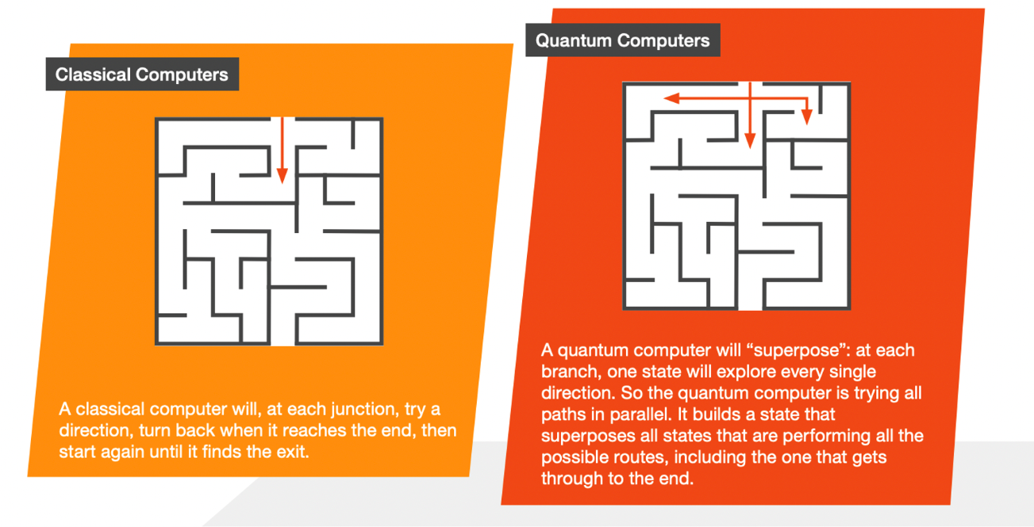
SECURITY EXPERTISE
HOW QC IS GROUNDBREAKING
XR ENTERPRISE APPLICATIONS
Quantum computers can perform multiple calculations simultaneously, making them significantly faster & accurate.
Reimagining workforce and customer engagement in a virtual world.
We can help you find an appropriate balance between security and transparency through an analysis of the below security considerations
Quantum computers are next generation supercomputers that perform parallel calculations using quantum mechanics, making them significantly faster than classical computers for certain types of problems.
Recent breakthroughs in QC has resulted in machines that need only 200 seconds to solve a problem that would take the world’s fastest supercomputer 10,000 years to figure out.
PwC Innovation Hub
Confidential information for the sole benefit and use of PwC’s client
Notes:
Stat sources:
Stat 1 -
Stat 2 -
Stat 3 - https://www.accenture.com/us-en/insights/technology/quantum-impact
https://www.prnewswire.com/news-releases/statistics-on-global-quantum-computing-market-size--share-to-surpass-usd-5274-9-mn-by-2030--exhibit-a-cagr-of-31-21--quantum-computing-industry-trends-value-analysis--forecast-report-by-zion-market-research-301724817.html#:~:text=In%20terms%20of%20revenue%2C%20the,computers%20in%20solving%20complex%20problems

Slide 13
IMPACT OF QUANTUM COMPUTING (QC)
How a major fast food chain optimized their delivery routing & hiring with quantum.
Quantum is already here – and soon, it will be everywhere.
We’re solving our most difficult problems for clients using production-ready quantum computing (QC) today, while also preparing for a future where quantum is ubiquitous.
Are you ready to be quantum-ready?
Saved in annual transport costs when ran once per month* (est. from 1 month run of $87k avg. savings)
$1M
PwC used quantum annealing to optimize delivery routing of 13,000+ stores in 4,643 cities across the US.
The Quantum Advantage:
203k
9.2k
136
Miles Saved Annually*
Hours Saved Annually*
Less Contractors Hired
PwC Innovation Hub
Confidential information for the sole benefit and use of PwC’s client
*Assuming that delivery is performed once-per-month with similar avg. savings.
12

Slide 14
THE TIME TO START IS NOW
QUANTUM QUBIT DEVELOPMENT & ENTERPRISE INVESTMENT
SECURITY EXPERTISE
Lead as a Quantum Fast-follower.
The technology growth curve is steepening. With Quantum, exponential developments will create exponential disruption. As QC advancements accelerate, a disproportionate share of the value will go to those who invest early.​
XR ENTERPRISE APPLICATIONS
Breakthrough Quantum Advantage
Mature & Competitive Market
Reimagining workforce and customer engagement in a virtual world.
We can help you find an appropriate balance between security and transparency through an analysis of the below security considerations
Logical Qubits + Expected Investment
2023
2030
2040
LATE ADOPTERS WILL FACE THE CHALLENGES NEEDED TO SCALE:
The scarcest resource will be talent to develop algorithms.
Providers are becoming increasingly reluctant to deploy them in client-facing work.
Computing resources will be limited in the period of early quantum advantage.
Providers must reserve capacity, and they are already vetting their opportunities to work with individual clients as they would a portfolio of investments.
Quantum computing solutions are custom and will take time to build.
The integration between quantum and classical resources is a particular challenge.
PwC Innovation Hub
Confidential information for the sole benefit and use of PwC’s client

Slide 15
QUANTUM JOURNEY
Key steps clients are going through on Quantum
Security policies and secure environment
Taking a trust-by-design approach and establishing security policies and secure environment.
1
Defining Quantum strategy to prioritize transformational use cases and enterprise readiness.
2
Quantum strategy
Building initial use cases by establishing a core team to accelerate speed, repeatability and control.
3
Initial use cases
Scaling use cases, building into workflows and applications and adapting use case patterns across the business
Generally includes new tooling and integration services with enterprise data and applications
Use cases at scale
4
Continuing focus on Quantum Computing governance,
security and
responsible QC
Continuing focus on Quantum governance, security and responsible QC
5
PwC Innovation Hub
Confidential information for the sole benefit and use of PwC’s client
14

Slide 16
PWC QUANTUM OFFERINGS
SECURITY EXPERTISE
We help deliver Innovation@Scale for you to become quantum-ready.
XR ENTERPRISE APPLICATIONS
Reimagining workforce and customer engagement in a virtual world.
Strategy
Build
Scale & Govern
Operate
We can help you find an appropriate balance between security and transparency through an analysis of the below security considerations
Quantum Use Case & Org Design
QC Strategy & Visioning
Current-state assessment
Business case development
Business process transformation prioritization
Identify, triage and prioritize initial use cases
Identify convergences with AI, blockchain, other new tech.
QC Use Case Development
Prepare pipeline data
Tune output using embedded data
Create applications/toolkits that leverage trained models to reimagine business processes
Scale and deploy use cases
Implement in workflows and applications
Governance & Org Models
Use case intake process
Codes of conduct with Quantum
Guiding principles to promote opportunities while managing potential downsides
Quantum tech stack & CoE creation
Quantum managed services
Ongoing operations
Data integrity and quality
Maintenance and support
Quantum Sustainability
QC Sustainability Strategy
Current-State Assessment
Carbon Footprint Calculation
Business Case Development
QC Sustainable Build
Develop use cases
Assess carbon tracking and ESG reporting.
Responsible QC Framework
Strategy
Control (Monitor & Report)
Responsible practices (Deployment)
Quantum Readiness Training & Workshops
Technical skill development
Executive training
Quantum-secure technology education
Vendor ecosystem
Cyber Risk Assessment
Assess and analyze the current security posture
Data scan & cryptography inventory
Governance/Process Gap Analysis
Secure Environment & Org
Design and build cryptographic algorithms
Security assessments, audits, penetration testing
Compliance with relevant regulations and standards
Crypto-Agile Operating Model
Adapt to emerging threats and new quantum-safe algorithms
Navigate & adapt to future regulations
Quantum Cyber Risk
PwC Innovation Hub
Confidential information for the sole benefit and use of PwC’s client

Slide 17
PWC QUANTUM OFFERINGS - STRATEGY
SECURITY EXPERTISE
We start with identifying opportunities for your business.
XR ENTERPRISE APPLICATIONS
Strategy
Build
Scale & Govern
Operate
Reimagining workforce and customer engagement in a virtual world.
We can help you find an appropriate balance between security and transparency through an analysis of the below security considerations
QC Strategy & Visioning
Education & Leading Practices
Level set on Quantum definition and scope
Bring outside-in perspective on potential opportunities
Generate first list of potential use cases to be further explored
Use Case Assessment & Prioritization
Asses high-level value and feasibility
Prioritize use cases and align on next steps
QC Cyber Readiness Quantum Risk Assessment Identify security gaps & risk exposure to quantum computer attacks.
Readiness Design & Roadmap Design a future-state plan to prepare for a quantum readiness transition.
Readiness Training & Workshops Educate leaders & teams to equip them on how to act on quantum risks
QC Sustainability Strategy Use Case Assessment & Prioritization
Asses high-level value and feasibility
Prioritize use cases and align on next steps
Use Case Assessment & Prioritization
Asses high-level value and feasibility
Prioritize use cases and align on next steps
Activities
Deliverables/ Outputs
Prioritized set of Quantum Use Cases
Workshops, Education & Training
Security Gap Analysis
Remediation Plan Design & Roadmap
Workshops, Education & Training
Sustainability Assessment
Carbon Footprint Calculation
Prioritized Set of Quantum Sustainability Use Cases
PwC Innovation Hub
Confidential information for the sole benefit and use of PwC’s client

Slide 18









THE PWC DIFFERENCE
We can help you become quantum-ready.
Innovation meets Expertise
We hold multiple patents and boast a dedicated team of quantum specialists. Our industry & functional expertise allows us to tailor quantum solutions that precisely match your needs.
Ecosystem & Alliances
Our formal Alliances and Enterprise Agreements with industry leaders gave us early access to their technologies and provide us a head start on developing solutions our clients’ needs.
A.I. Talent & Tools
We have scaled capabilities in managing and developing AI solutions backed with classical-quantum hybrid framework.
Our AI leadership has been recognized by:
5+ Quantum Patents,
5+ Research Publications
PwC Innovation Hub
Confidential information for the sole benefit and use of PwC’s client

Slide 19

Our collaborative ecosystem of academic and research institutions help us deepen our understanding of market needs and develop new innovations to deliver greater value to you.
The Americas
Carnegie Mellon Innovation Lab
Carnegie Mellon Risk & Regulation Lab
MIT AI Lab
MIT Computer Science Lab
MIT Sloan (Simulation)
Johns Hopkins University
Stanford University, Human-Centered AI
University of California San Diego, Calit2
University of Chicago
Asia and Pacific
Institute for Infocomm Research
Tokyo Institute of Technology
Heriot Watt University, Dubai
University of Sydney
Africa
University of Cape Town
Europe
Oxford University
Cambridge University
University of Leeds
University of Edinburgh
École Polytechnique
Fédérale de Lausanne
Fraunhofer Institute
Free University of Amsterdam
Tilburg University
*The above list is not exhaustive.
PwC Innovation Hub
Confidential information for the sole benefit and use of PwC’s client
19

Slide 20
Start exploring.
Learn more about Quantum Computing and how it can bring new value to your organization at PwC.com.
PwC Innovation Hub
Confidential information for the sole benefit and use of PwC’s client
20

Slide 21




Get in touch.
Scott Likens
GLOBAL AI & INNOVATION TECHNOLOGY LEAD
INNOVATION HUB, PARTNER
scott.likens@pwc.com
Joseph Voyles
ARTIFICIAL INTELLIGENCE LEAD, INNOVATION HUB, PARTNER
joseph.voyles@pwc.com
Dr. Arit Kumar Bishwas
QUANTUM COMPUTING LEAD, INNOVATION HUB, DIRECTOR
arit.kumar.bishwas@pwc.com

Slide 22
Our Impact
03
PwC Innovation Hub
Confidential information for the sole benefit and use of PwC’s client

Slide 23
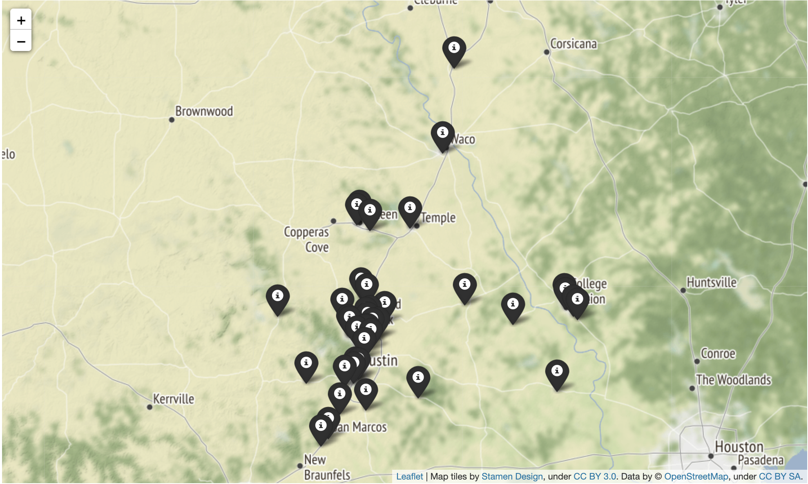
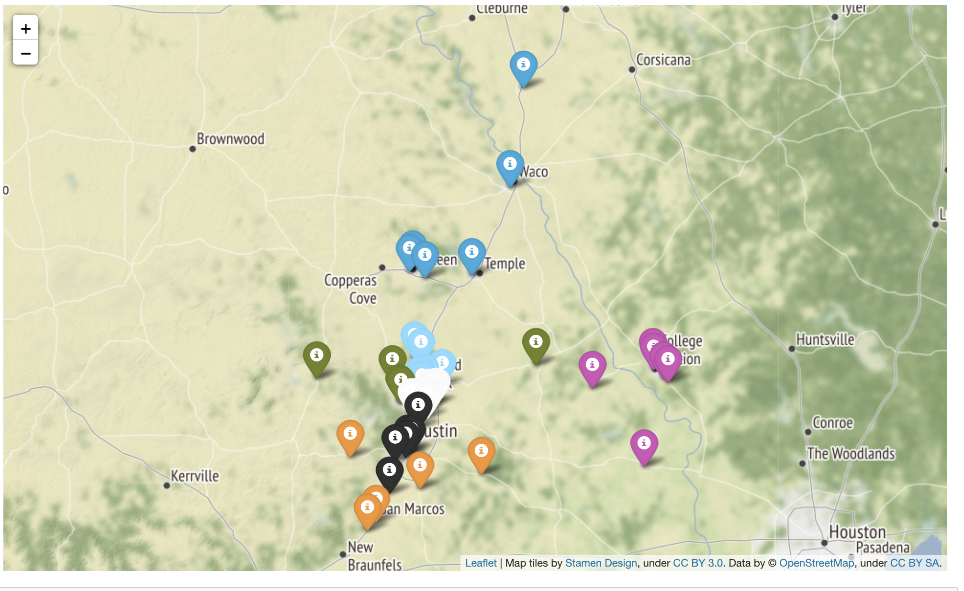

Relevant tech: Quantum Computing
Agent Route Optimization
01. What’s the situation?
Many businesses require to assign agents to various stores (or locations) in order to accomplish certain tasks. This assignment involves certain complex constraints on time, distance and number of personnel, which needs to be optimized. Currently such tasks are considered NP-hard problem and involves solutions based on greedy search algorithms or genetic algorithm.
02. What is our solution?
Developed a quantum annealing based solution which can optimize the assignment process using Constrained Quadratic Models. Based on the solution, the number of personnel required, their respective routes etc can be calculated.
03. What are the benefits?
Better quality of solution consisting of optimized routes along with significant reduction of the time taken for the calculation of the solution.
More than 11% of time and 33% of solution runtime can be saved using this method.
PwC Innovation Hub
Confidential information for the sole benefit and use of PwC’s client
23
Notes:
Lily

Slide 24

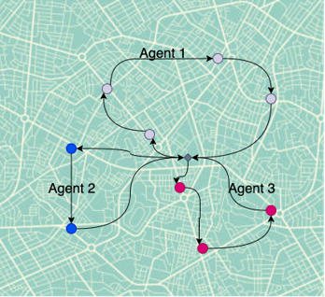
Problem Statement
Optimizing routes for multiple store inspections to minimize costs by strategically deploying a precise number of agents/contractors.
Input: Latitude and longitude of outlets​
Output: Route of agents
PwC Innovation Hub
Confidential information for the sole benefit and use of PwC’s client

Slide 25
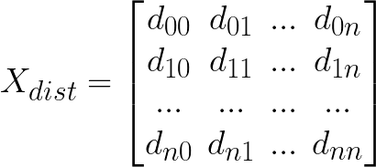
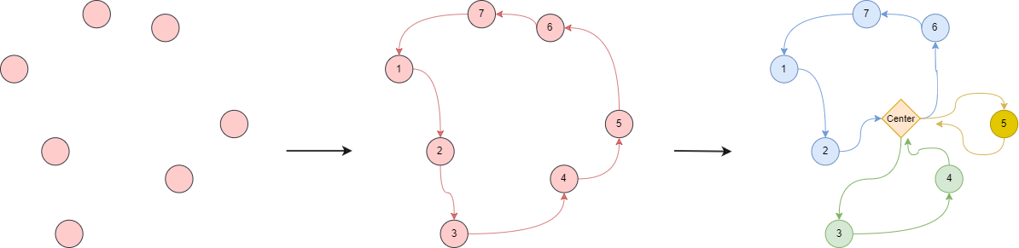
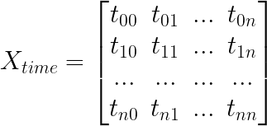
Classical
Quantum
Data Collection and Preprocessing
Clustering
TSP Solver: Finding the most efficient route that covers all the stores essentially converting it into Travelling Salesman Problem (TSP).
Route Solver: Breaking the route in segments for each agent based on the following constraints:
The number of parts (i.e. number of agents) should be minimum.
The time to traverse each part should be ≤8 hours (i.e. the working hours).
Route calculation
Creation of clusters (if required)
Its dependent on the hardware limitations
Collection of location data comprising of Latitude and Longitude
Filtering out locations with certain properties and restrictions
Calculation of the time and distance matrices
TSP Solver
Route Solver
PwC Innovation Hub
Confidential information for the sole benefit and use of PwC’s client

Slide 26
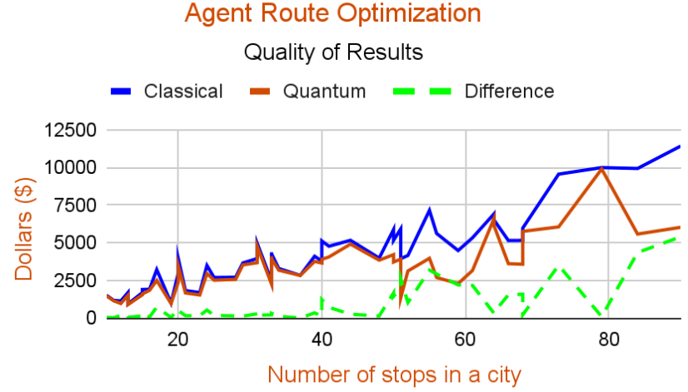
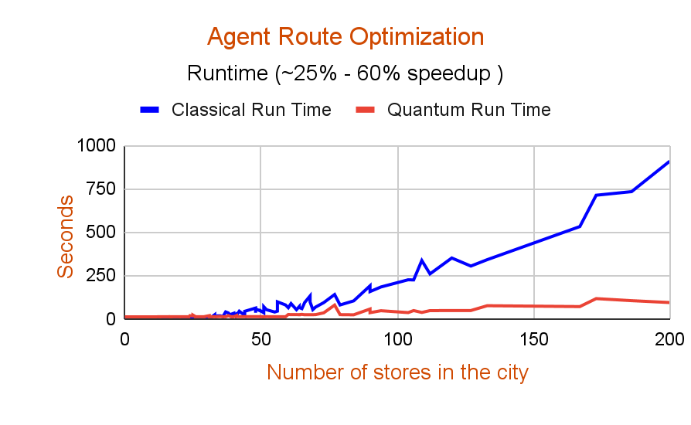
Results
For 98 cities
Assumptions (these are illustrative for the example)
Per Mile: $ 1.15
Per Hour: $ 30.00
Per Overnight: $ 160.00
 | % improvement as compared to classical solution
Total Agents required | 12.2 %
Total Distance travelled by agents | 9.48 %
Total work hours of the agents | 8.67 %
PwC Innovation Hub
Confidential information for the sole benefit and use of PwC’s client
26
Notes:
Find overall cost for the entire solution to check on the dollar values saved.

Slide 27


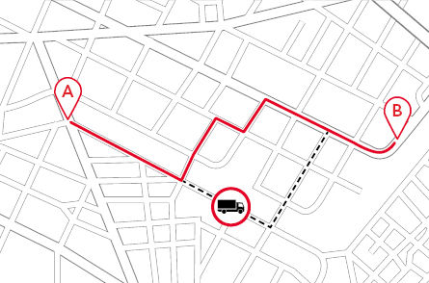
Relevant tech: Quantum Computing
Traffic Flow Optimization
01. What’s the situation?
Many cities need to minimize the time taken by a given set of cars to travel from a particular source to a particular destination by reducing congestion over road segments
02. What is our solution?
Developed a quantum annealing based solution which can optimize the traffic flow using Quadratic Unconstrained Binary Optimization (QUBO).
QUBO was formulated using occupancy cost of a particular segment as function of the binary variables associated with routes that share it. For each segment penalize it according to weight of vehicles allocated to it.
03. What are the benefits?
The input can be entered with any number of classes of vehicles and the QUBO can be solved using various solvers depending on the requirements.
Hybrid solvers can speed up the solving process upto 70% while giving almost the same level of optimization.
Quantum solvers are able to provide a slightly better optimized solution as compared to classical solvers in complex cases.
PwC Innovation Hub
Confidential information for the sole benefit and use of PwC’s client
27
Notes:
Lily

Slide 28

Relevant tech: Quantum Computing
Quantum cryptography
01. What’s the situation?
Modern cryptographers emphasize that security should not depend on the secrecy of the encryption method (or algorithm), only the secrecy of the keys. The secret keys must not be revealed when plaintext and ciphertext are compared, and no person should have knowledge of the key. The design of secure systems using encryption techniques focuses mainly on the protection of (secret) keys.
02. What is our solution?
Unlike “conventional” encryption based on mathematical algorithms, QKD will not be compromised by the continual increase in computing power or mathematical progress.
It thus ensures true future-proofed security of key distribution.QKD derives its security from the proven principles of quantum physics - namely, that the generation of the quantum key is truly random, and that any interruption or eavesdropping of the data will perturb the system and can thus be detected.
It basically depends on two major principle- Heisenberg Uncertainty principle and principle of photon polarization.
03. What are the benefits?
Modern algorithms are based on mathematically difficult problems - for example, prime number factorization, discrete logarithms, etc. There is no mathematical proof that these problems are in fact are hard, just empirical evidence. Modern cryptographic algorithms are too complex to be executed by humans because of unpredictable nature of quantum physics..
Today's algorithms are executed by specialized hardware devices, and in most cases are implemented in computer software. Keys can be protected either by encrypting them under other keys or by protecting them physically, while the algorithm used to encrypt the data is made public and subjected to intense scrutiny.
PwC Innovation Hub
Confidential information for the sole benefit and use of PwC’s client
28
Notes:
Lily

Slide 29


Relevant tech: Quantum Computing
Quantum Natural Language Processing
01. What’s the situation?
Semantic and pragmatic analysis in classical NLP is very much resource-intensive. Automating the understanding and analytical ability of NLP models while dealing with enormous data set cause significant time and computational resource overhead leading to uncertain outcome and inaccurate precision.
02. What is our solution?
Quantum enabled NLP can convert sentences into quantum circuits using sentence structure (syntax) and meaning (semantics) using quantum entanglement to drastically speed up the training process.
Our approach is to use DisCoCat framework and ZX calculus to parse sentences and optimize generated quantum circuits to run more complex data in today’s available superconducting qubit based quantum hardware.
03. What are the benefits?
Quantum-enabled NLP has the potential to outperform classical NLP in terms of better training accuracy and lesser training time when number of inputs are significantly high. In addition to that, due to faster computation, this will consume less power than the available high-end transformer NLP models.
PwC Innovation Hub
Confidential information for the sole benefit and use of PwC’s client
29
Notes:
Lily

Slide 30

Relevant tech: Quantum Computing
Quantum Random Number Generator
01. What’s the situation?
Existing pseudo random number generators (PRNG) rely on mathematical functions to generate random numbers which has diverse range of applications like in cybersecurity, statistical analysis, simulation, BFSI, defense and many more. Challenges with these generators are of less entropy/ randomness produced which causes easy predictability of random bits. Another set of available RNG is Hardware based, which has a very slow bit generation rate and also susceptible to physics of the underlying hardware.
02. What is our solution?
Quantum RNGs are based on principles of quantum physics which is non-deterministic in nature and are able to generate true random bits. Existing quantum RNGs are able to provide significant entropy required for security-intensive applications. Our QRNG enabled solutions can prove to be quantum-safe in post-quantum era. Our objective is to extract the maximum number of entropy from the underlying quantum device and to propose a quantum key as a service model.
03. What are the benefits?
Quantum RNGs can produce bits with enhanced security level, statistically non correlated, unbiased random numbers which can be used further for creating dynamic QR, captcha, secure cryptographic key, initial seed for sampling, OTP etc. QRNG market value in 2022 was 300 million U.S. dollars, which has a projected growth rate of 35% by 2025.
PwC Innovation Hub
Confidential information for the sole benefit and use of PwC’s client
30
Notes:
Lily

